Slide 1
Emotional Intelligence
-
A path to career success

Slide 2
Self-Awareness

Slide 3
Meaning: Knowing one’s own -
Attitudes - Opinions
Feelings - Emotions
Motives - Purpose
Strengths - Weaknesses

Slide 4

6 Ways to Create Self-Awareness:
Ask For Feedback
Recognise Your Strengths & Weaknesses
Self-Reflect
Monitor Your Self-Talk
Practice Saying “No”
Question Your Decisions

Slide 5
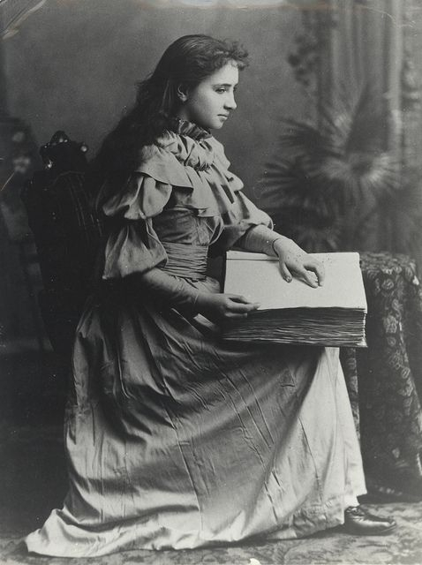
Case Study - Helen Keller

Slide 6

Case Study - Helen Keller

Slide 7
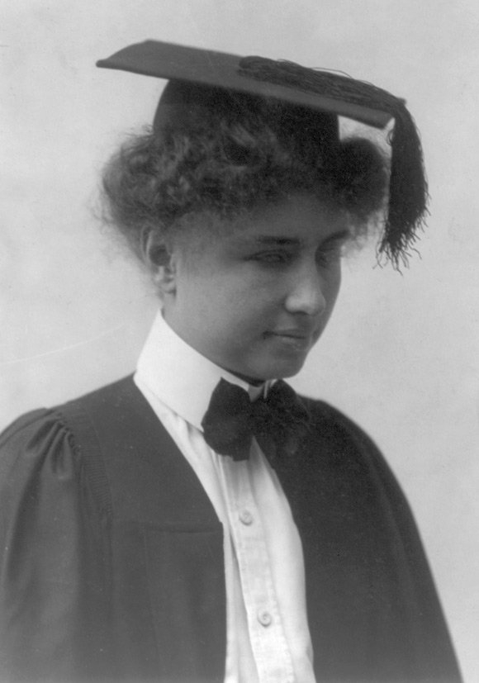
Case Study - Helen Keller

Slide 8
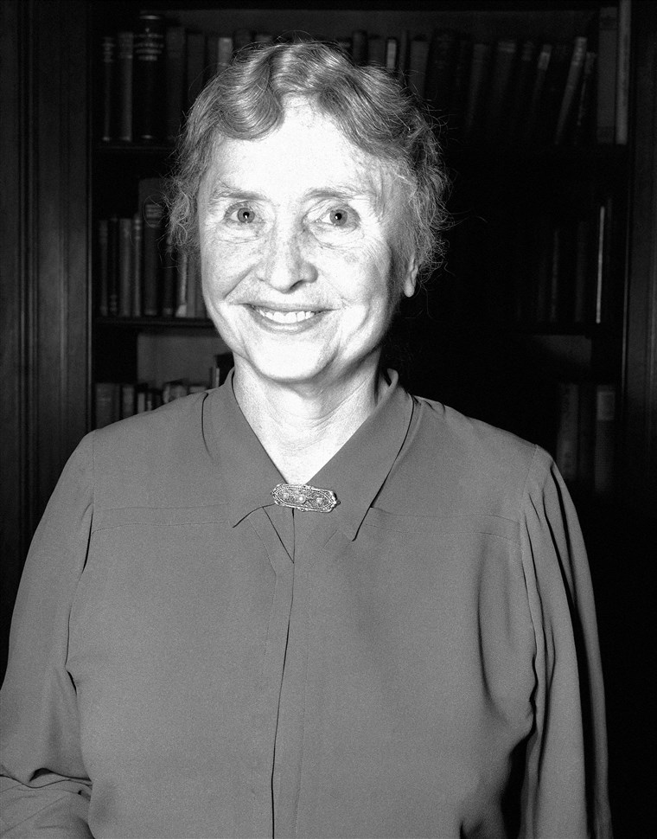
Case Study - Helen Keller

Slide 9
Self Management

Slide 10
What is Self Management?
Sounds like being your own boss?
Not really,it means taking responsibility for one's own behavior and well being
Self Management is about making a choice to do more than you need to, and it is a great skill to build for life and work

Slide 11
Three key Self Management skills
Initiative
Organize yourself
Accountability

Slide 12
Causes of Obsessional Ruminations (Case Study)
Forms of Recognition
Promotion
Family Time
Health
Working Sector
Bosses and Colleagues

Slide 13
Self-Management(Case Study)
Self - Therapy (Attentional Distraction Technique):

Slide 14
Self-Management (Case Study)
Outcomes:
Natural development of
Self-confidence
Initiative
Perseverance
Life satisfaction.

Slide 15
Social Awareness

Slide 16
What is Social Awareness ?
Social Awareness is the ability to know and feel the people around you and the ability to interact with them in the most efficient and proper manner.

Slide 17
The waiter who suggests something better from the menu...
...the salesperson who goes the extra mile...
...the supportive team leader...
...and the executive that remembers your name -
...each of these have one thing in common...
They excel in social awareness!

Slide 18
According to Daniel Goleman, an expert in this field, there are three competencies that you’ll have to develop in order to grow your social awareness skills.
1. Empathy
2. Organizational awareness
3. Service orientation

Slide 19
How to build social awareness:
1. Develop self-awareness
2. Observe others
3. Cultivate mindfulness
4. Practice forgiveness

Slide 20
Social Awareness Case Study
What social awareness basically means.
Why I'm choosing the case study.
The Case Study.
What we can learn from this?

Slide 21
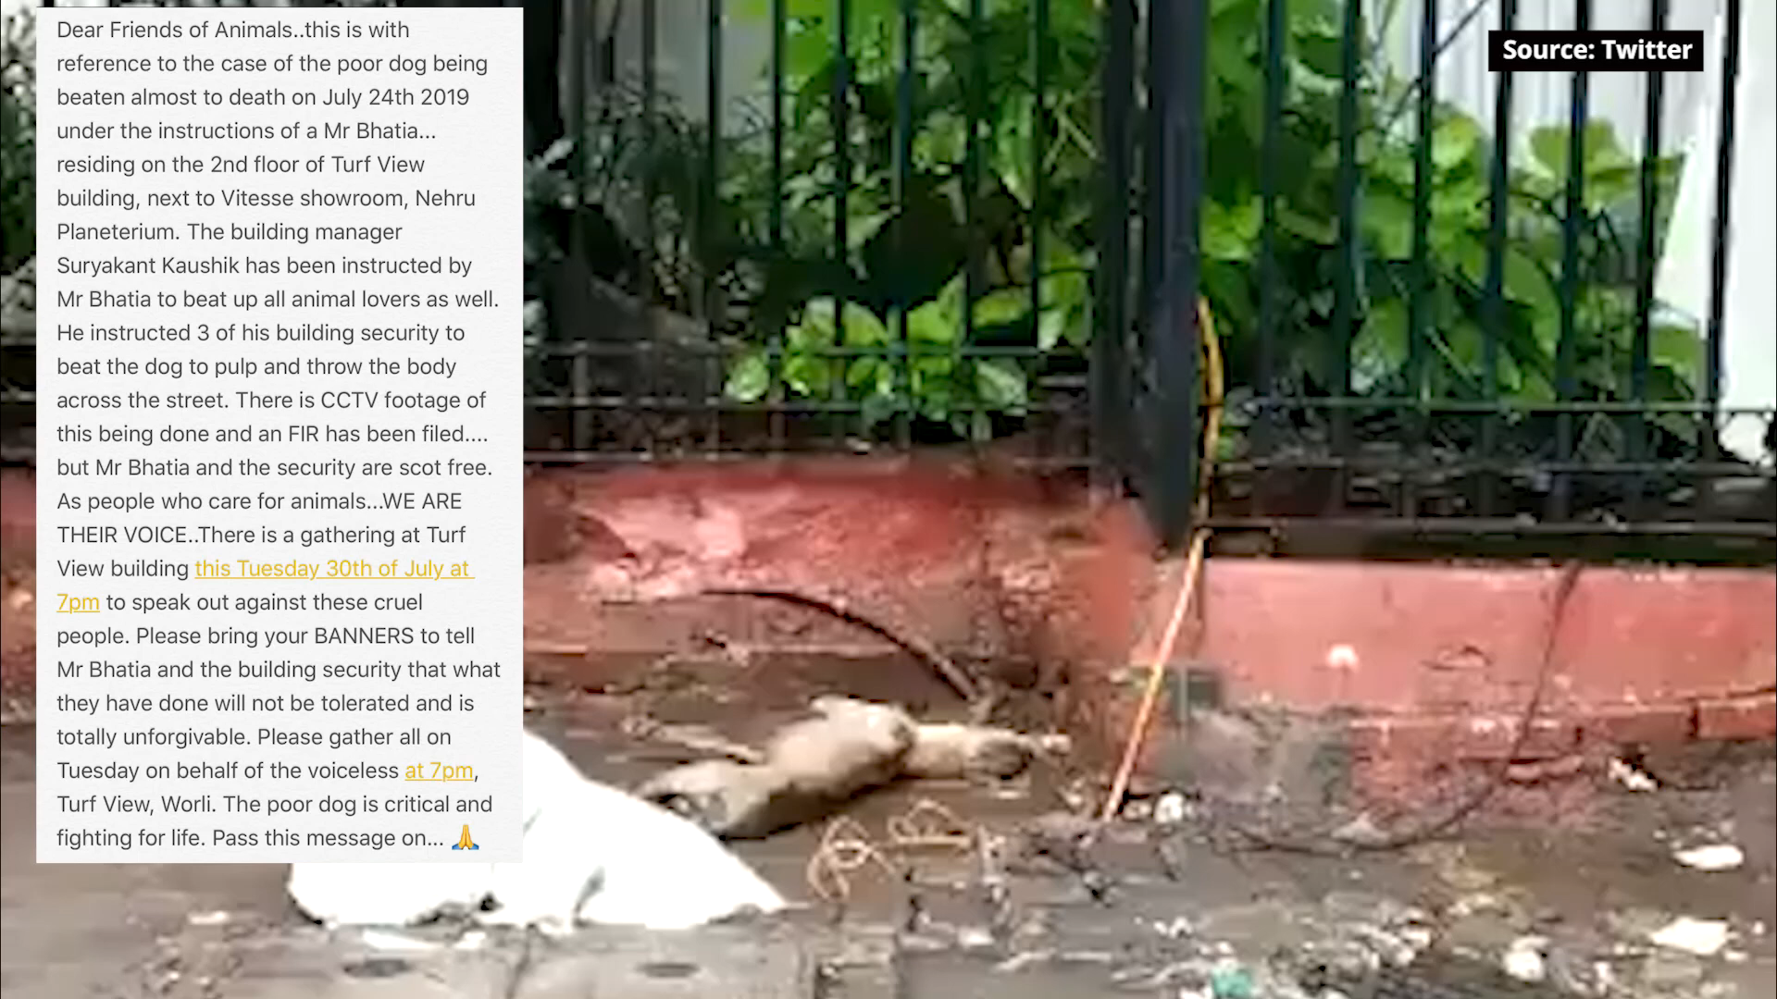

Slide 22
Relationship Management

Slide 23
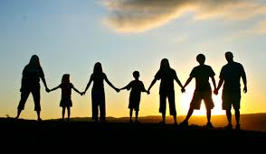
What is Relationship Management?
This is the ability to be self aware about your emotions as well as other people’s emotions in order to manage relations properly.
It is the bond that you develop with people over time.
This skill is vital in resolving conflicts and negotiating successfully with others.

Slide 24
Vital relation management tips:
Take feedback well.
Don’t avoid the inevitable.
Maintain your natural style of speaking.

Slide 25

Case Study: 300 - The Movie

Slide 26

Key Points:
Battle against Persians.
Heavily outnumbered
Confidence in Leader
Goal = WINNING

Slide 27

Group:-
“Two or more persons who are intracting with one another in such a manner that each person influences and is influenced by each other person”
-Shaw M.;1981

Slide 28
Competencies:-
Influence
Inspirational leadership
Conflict management
Building bonds
Team work and Collabration

Slide 29
Conclusion
Relationship management
Social Awareness
Self Management
Self Awareness

